Slide 1
Computer Networks and Internets
《计算机网络与因特网》课件
林坤辉

Slide 2
PART IV Packet Transmission
Chapter 20（2） Protocols and Layering
协议与分层

Slide 3

20.2 The Need For Protocols
All parties involved in a communication must agree on a set of rules to be used when exchanging messages.
such an agreement is called a protocol(协议).
Network protocol(网络协议): a set of rules that specify the format of messages and the appropriate action required for each message .
The software that implements such rules is called protocol software(协议软件).

Slide 4
20.3 Protocol Suites协议系列
To divide the communication problem into subpieces and to design a separate protocol for each subpiece.
Doing so make each protocol easier to design,analyze,implement,and test.
Each protocol should handle part of the communication problem not handled by other protocols.
Protocol should can share data structures and information.

Slide 5
The combination of protocols should handle all possible hardware failures or other exceptional condition.
Protocol are designed and developed in complete,cooperative sets called suites(系列) or families(族) .
Each protocol in a suite solves one part of the communication problem; together,they solve the entire communication problem.

Slide 6
20.4 A Plan For Protocol Design
Layering model(分层模型).
The communication problem can be divided into subpieces, called layers(层) .
A protocol suite can be designed by specifying a protocol that corresponds to each layer.
A layering model is a tool to help protocol designers construct a suite of protocols that solves all communication problems.

Slide 7
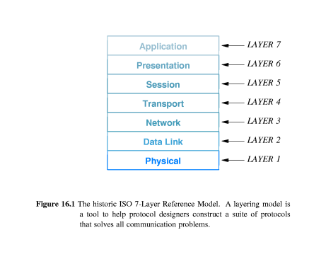
20.5 The Seven Layers
ISO defined a 7-layer Reference Model.

Slide 8
20.6 Stacks: Layered Software
栈：分层软件
The protocol software on each computer is divided into modules, with one module corresponding to each layer.
Layering determines the interaction among modules.
Each computer contains software for an entire suite of protocols.
Vendors use the term stack(栈) to refer to such software.

Slide 9
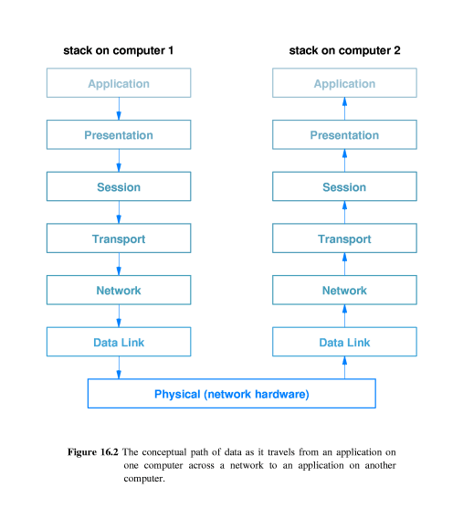

Slide 10
物理层
相关层
  硬件设备
  链路层
作用
  完成对bit和载波之间的转换
  处理与物理传输介质相关的接口

Slide 11

链路层
相关层
  物理层
  网络层
作用
  分为介质访问控制子层(MAC)和逻辑链路控制子层(LLC)
  MAC子层
    解决广播型网络中多用户竞争
  LLC子层
    链路差错控制、帧校验
    链路流量控制

Slide 12
网络层
相关层
  数据链路层
  传输层
作用
  负责点到点通信
  寻径
  流量控制
  拥塞控制

Slide 13
传输层
相关层
  网络层
  会话层
作用
  给上层提供通用的应用界面
  屏蔽网络层带来的数据表示结构的差异，实现端到端通信
  提供进程间通信机制
  提供传输的可靠性

Slide 14
会话层
相关层
  传输层
  表示层
作用
  会话建立、撤销
  传输同步
  面向连接的交互活动管理
    口令认证
    数据传输规范

Slide 15
表示层
相关层
  会话层
  应用层
作用
  信息压缩
  信息加密、解密
  与标准格式的转换

Slide 16
应用层
相关层
  表示层
  用户或者上层应用系统
作用
  提供最通用的应用程序（电子邮件、BBS、Web、文件传输等）
  完成用户信息或者软件转换信息的交互

Slide 17
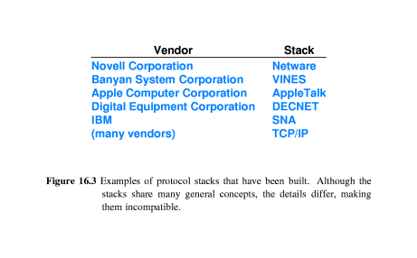
Because each stack has been designed independently.
Protocol from a given stack cannot interact with protocols from another.
A computer can run more than one stack at the same time.

Slide 18
20.7 How Layered Software Works
Software in a given layer on the sending computer adds information to the outgoing data.
Software in the same layer on the receiving computer uses the additional information to process incoming data.

Slide 19
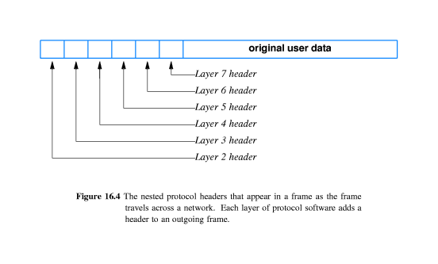
20.8 Multiplex, Nested Headers
多层嵌套头部

Slide 20

ISO-OSI层次模型的软件功能(1)
分层的数据结构
  数据头
    抽象的概念，不一定在开始位置
  有效数据
    有可能经过一定的修正
N+1层数据头
N+1层有效数据
N层数据头
N层有效数据

Slide 21
ISO-OSI层次模型的软件功能(2)
层次间的调用关系
  底层为上层提供服务访问点(SAP)作为接口
  上层通过统一的SAP底层功能
SAP(n+1)
N+1层
SAP(n)
N层

Slide 22
ISO-OSI的优势与问题
优势
  结构清晰
  软件重用
  规格统一，减少冲突
问题
  高层很难对低层通信进行优化
  层次过多、过细，软件要求复杂
  传输效率低

Slide 23
20.9 The Scientific Basis For Layering 分层的科学依据
Layering principle:
Layer N software on the destination computer must receive the exact message sent by layer N software on the sending computer.
Layering simplifies protocol design and testing.

Slide 24
20.10 Techniques Protocols Use 协议使用的技术
16.10.1 Sequencing For Out-of-Order Delivery 无序传递的排序.
16.10.2 Sequencing To Eliminate Duplicate Packets排序消除重复包.
16.10.3 Retransmitting Lost Packets重发丢失的包.
16.10.4 Avoiding Replay Caused By Excessive Delay避免过量延迟导致的重播
16.10.5 Flow Control To Prevent Overrun
控制流量以防止数据过载

Slide 25
20.10.1 Sequencing For Out-of-Order Delivery 无序传递的排序
A connectionless network system that can change routes may deliver packets out of order.
To handle out-of-order deliveries,transport protocol use sequencing.

Slide 26
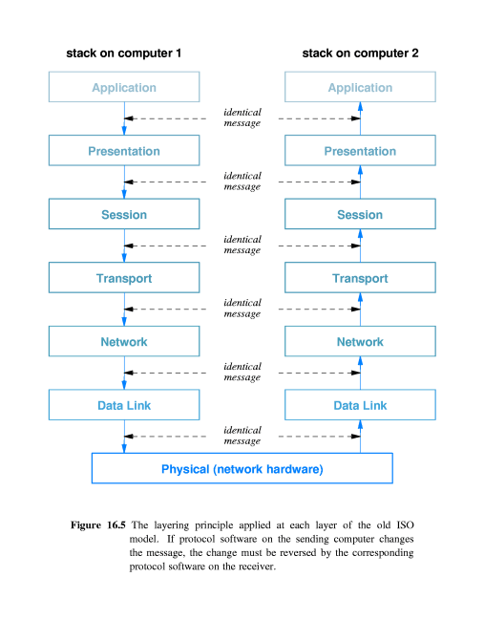

Slide 27
20.10.2 Sequencing To Eliminate Duplicate Packets
排序消除重复包
Malfunctioning hardware can cause packets to be duplicated.
Sequencing solves the problem of duplication.

Slide 28
20.10.3 Retransmitting Lost Packets重发丢失的包
Packet loss is fundamental problem.
Protocols use positive acknowledgement with retransmission(带重发的确认).
Acknowledgement(ACK确认)
Retransmitting(重发)
Retransmission can introduce duplicate packets.

Slide 29
20.10.4 Avoiding Replay Caused By Excessive Delay
避免过量延迟导致的重播
One source of delay Packet switching system arises from the store-and-forward approach.
Extraordinary delays can lead to replay errors(重播错误).
To prevent replay,protocols mark each session with a unique ID,and require the unique ID to be present in each packet.

Slide 30
20.10.5 Flow Control To Prevent Overrun
控制流量以防止数据过载
Data overrun(过载) occurs when a computer sends data across a network faster than the destination can absorb it.
Flow control(控制流量) mechanism.
The simplest form of flow control is a Stop-and-go(停等) system.

Slide 31
Stop-and-go(停等) protocols can cause extremely inefficient use of network capacity.
To obtain high throughput rates, protocols use a flow control technique known as sliding window(为滑动窗口).
The sender and receiver are programmed to use a fixed window size, which is the maximum amount of data that can be sent before an acknowledgement arrives.

Slide 32
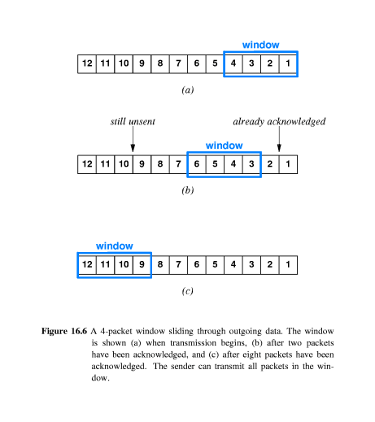

Slide 33
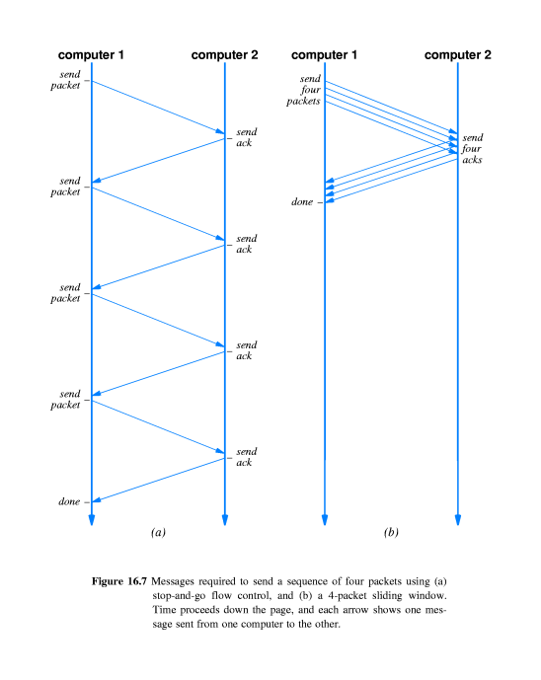
T_{w}=min(B, T_{g} X W)

Slide 34
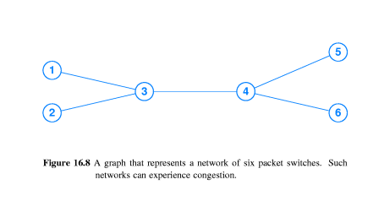
20.10.6 Mechanisms To Avoid Network Congestion
避免网络拥塞的机制
Congestion(拥塞) is a fundamental problem in packet switching systems.
congestion collapse(拥塞崩溃).

Slide 35
Protocols attempt to avoid congestion collapse by monitoring the network :
Arrange for packet switches to inform senders when congestion occurs.
Use packet loss as an estimate of congestion.

Slide 36
作业
网络协议为什么要分层？
ISO-OSI参考模型包括哪些层次，各有什么作用？不同层次数据包结构如何设计？

